Slide 1

CU Research Computing Summer Camp

Slide 2
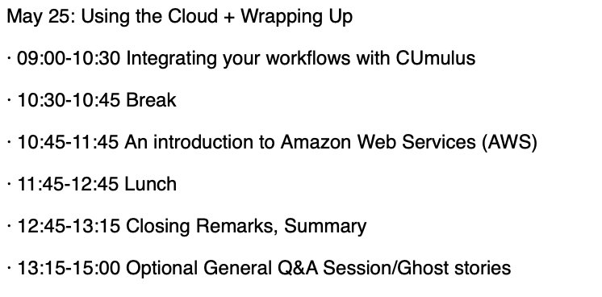
Today’s Agenda

Slide 3
Hands-on with CUmulus: a free Research Cloud platform

Slide 4
Getting Started on CUmulus
Andrew Wilson (RC User Support)
www.rc.colorado.edu
rc-help@colorado.edu

Slide 5
Learning Objectives
Logging into CUmulus with Horizon (the CUmulus web portal)
Creating your instance (i.e. virtual machine)
Logging into your instance via ssh

Slide 6
Account Setup for Demo
What’s needed for today:
ACCESS-CI (all other RMACC institutions)
Create account: https://identity.access-ci.org/new-user
Configure 2FA (Duo)
CU Research Computing account
Only needed to login to Instance
ondemand-rmacc.rc.colorado.edu
We’ll need:
your ACCESS or XSEDE username
your institutional affiliation (e.g., "University of Awesome")
your role (undergraduate graduate student, postdoc, staff, instructor, faculty or affiliated faculty)
your department
Your First and Last Name
Your preferred email address for communication

Slide 7
Outline
CU Research Computing Overview
What is CUmulus?
CUmulus Access
Access to CUmulus and the allocation process
Logging into Horizon (CUmulus web portal)
Creation of an instance
Logging into your instance
Demo workflow one might use on CUmulus:
Connect CUmulus to the Alpine HPC

Slide 8
CU Research Computing Overview
Provides Computing and Data Storage Beyond standard desktop resources:
High Performance Computing (HCP), clusters include:
Alpine
Blanca
Storage of Research Data
PetaLibrary
High-Speed Data Transfer
Globus Endpoint
Cloud Resources
CUmulus (On-premise Cloud)
Cloud Foundations (Commercial Cloud)
Secure Cloud Resources
Consulting in Computational Science and Data Management

Slide 9

CU Research Computing Overview

Slide 10
What is CUmulus?
CUmulus is CU Research Computing's free-to-use on-premise cloud service
Supports cases not well-suited for HPC such as:
Research-Oriented Web Servers
Databases
Long-Running Services
Research Hubs (Jupyterhub, RStudio Server, etc)
Provides users with persistent or ongoing availability by allocating logically isolated section of the cloud

Slide 11
What is CUmulus?
You get your own virtual environment for experimentation - an environment that can be easily created/tested/removed
Install Software
Administer your instance (you’re in control!)
Run applications and jobs
Interface w/ other CURC services: Blanca, Alpine, PetaLibrary
You can request specific resources (CPU, storage, memory) and can set up persistent storage

Slide 12
Example Use Case: Open Access Research Tool
Researcher wanted to publish and host trainings for a custom language processing tool that helps to build language databases and tools (think auto-correct) for endangered languages
Needs:
A web-based dashboard where any user can load and use the tools the research team developed
Persistent storage of data
Compute ability to continuously mine the data and advance algorithm
They were able to:
Setup a Jupyterhub instance where they control access of users
Have an environment where researchers around the world can easily use their research tools
Collect the incoming test data and use that for future training
Have the resources for persistent storage of large datasets and compute resources
12

Slide 13
Example Use Case: Persistent Data Mining
Researcher wanted to use online text database to train novel search algorithm
Needs:
Persistent Querying of an online text database
Persistent storage of data
Compute ability to continuously mine the data and advance their algorithm
They were able to:
Setup a data stream that queries data from Reddit at specified times of the day
Have the resources for persistent storage of large datasets and compute resources
Test and develop their novel search mechanism
13

Slide 14
Example Use Case: Galaxy Server
Researcher wanted to create a custom Galaxy Server (web-based GUI for popular bioinformatics software)
Needs:
A way to host a website that the researchers can use to load and analyze data, create reports and schedule compute jobs
Persistent storage of data
The ability to create compute jobs on the virtual machine or send jobs to the Alpine Supercomputer
Run persistent jobs (multiple days long)
They were able to:
Host the website, and control access of users who can access it
Have the resources for persistent storage of large datasets and compute resources
Create an interface to send jobs to the Alpine Supercomputer, all controlled via GUI
Test custom tools and data pipelines that they created
14

Slide 15
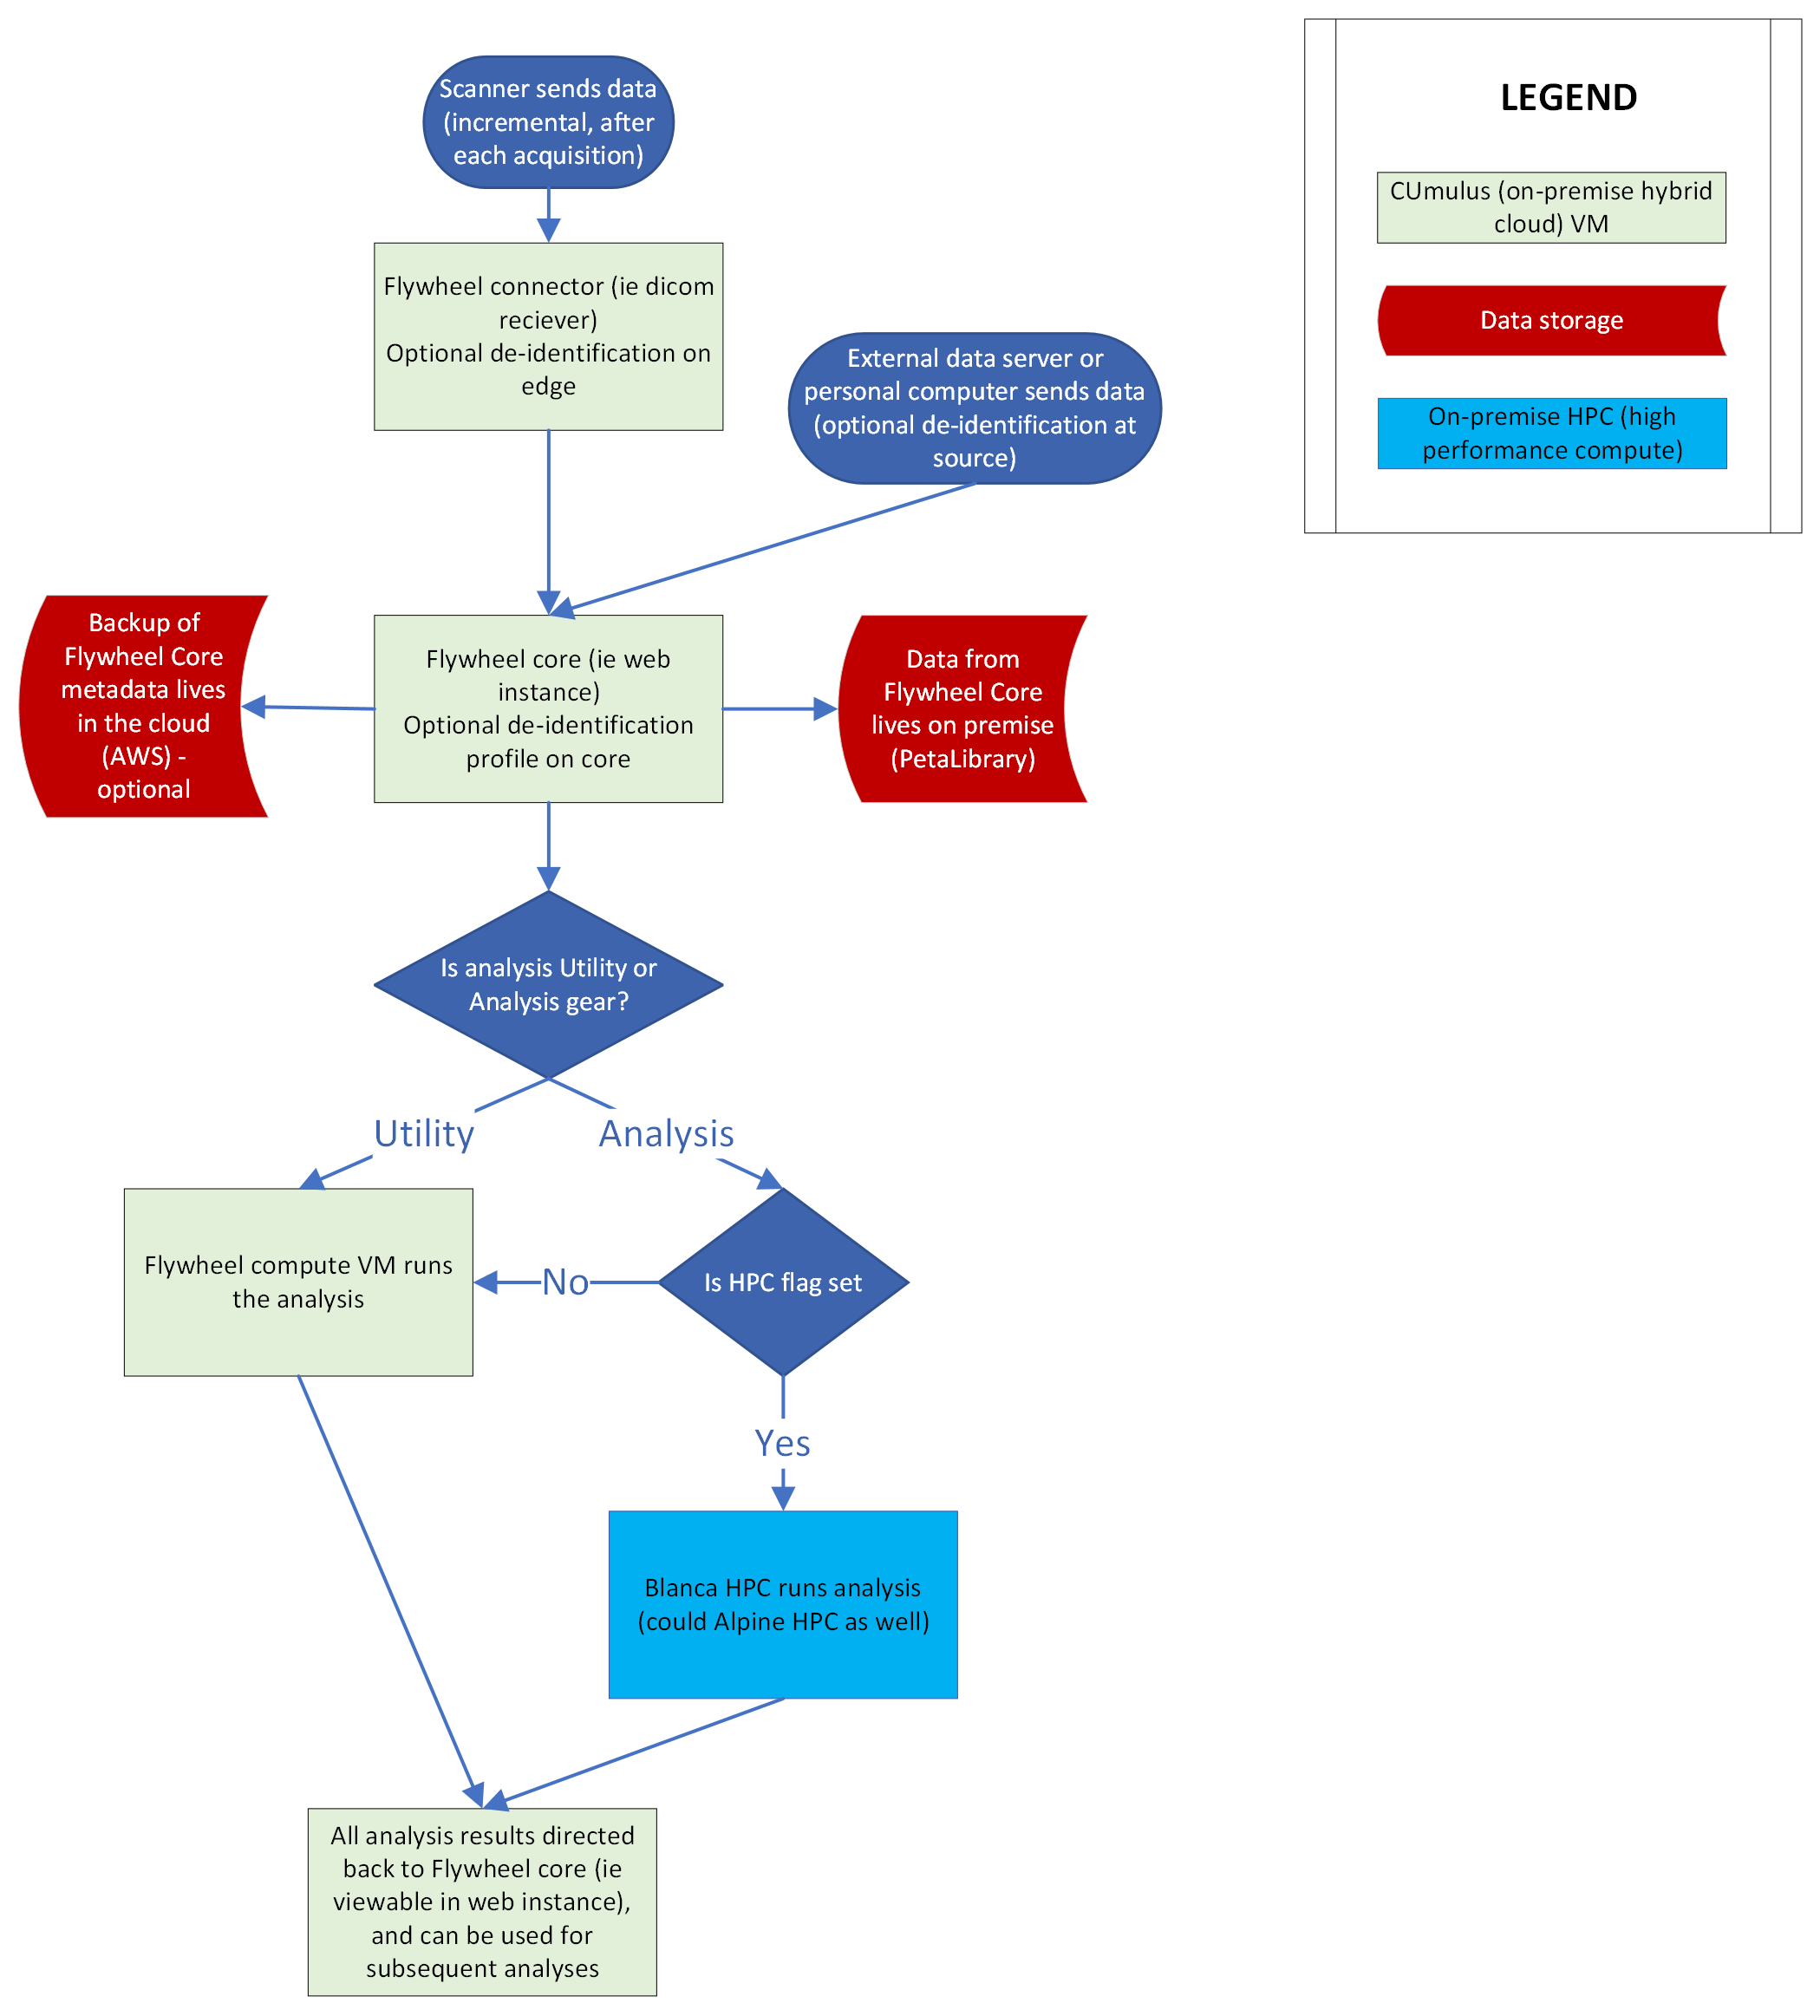
Example Use Case: Flywheel Project
Researcher wanted to create a tool that interfaces with MRI machines in the area and pulls data to a persistent web application where they can create processing pipelines and send these to the Alpine Supercomputer
Needs:
A web-based dashboard where users can develop processing pipelines, move data, and create compute jobs
Persistent storage of data (very large datasets)
Compute ability to continuously process the data
They were able to:
Setup a Flywheel Dashboard, a web-based application that researchers can access from anywhere.
Store data on the VM or in PetaLibrary or AWS
Send jobs to the Alpine Supercomputer for faster processing
15

Slide 16
CUmulus Access

Slide 17
CUmulus Access and Allocation
Submit a proposal for your use case (email rc-help@colorado.edu)
Describe your CUmulus workflow
Describe why your workflow is appropriate for CUmulus
Estimate the resources you require:
Operating System, CPU cores, Disk Space, Memory
This is an iterative process where we work with you to make sure the request for resources fits your (and our) needs
Learn more about the allocation request process at https://curc.readthedocs.io/en/latest/cloud/cumulus.html

Slide 18
Log in to Horizon
There are 3 current authentication/login methods at cumulus.rc.colorado.edu/:
CU Boulder
CSU Fort Collins
ACCESS-CI (all other RMACC institutions)
Create account: https://identity.access-ci.org/new-user
Configure 2FA (Duo)

Slide 19
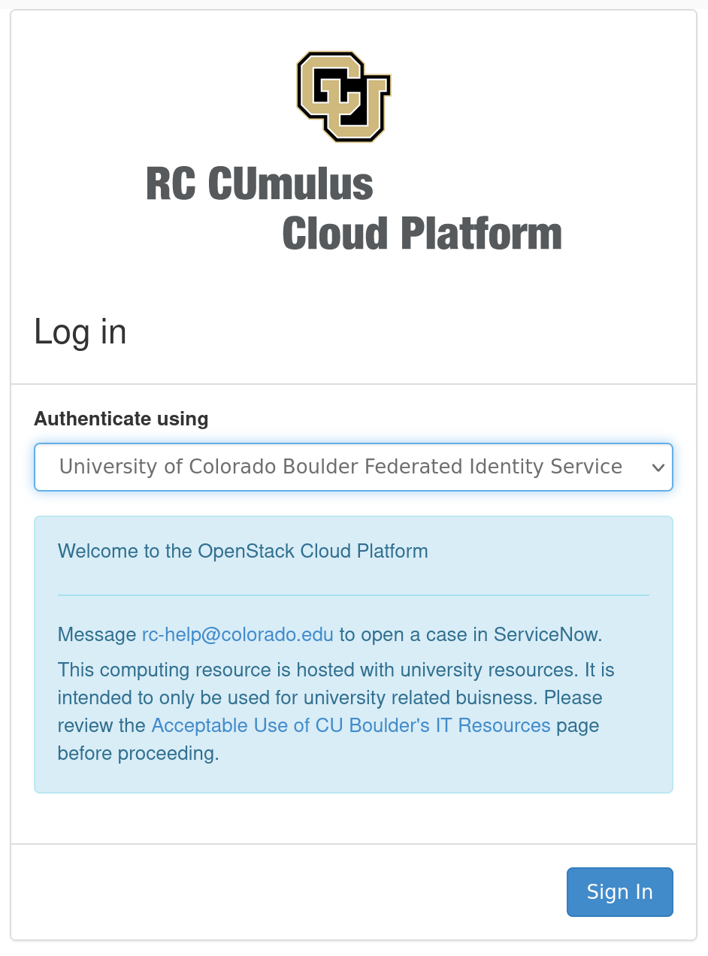
Log in to Horizon
Horizon is the CUmulus web portal
cumulus.rc.colorado.edu/
Let’s take a brief tour of Horizon
Log in with your institution’s credentials:
If you’re using your ACCESS-CI Account
Choose: ‘Access-CI Identity Provider’

Slide 20
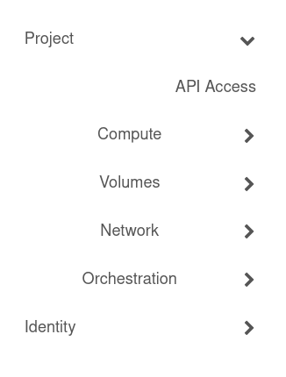
Navigate Horizon
Choose your project (top left)
Generally users only have 1 project
4 main sections
Compute
Volumes
Networks
Orchestration

Slide 21
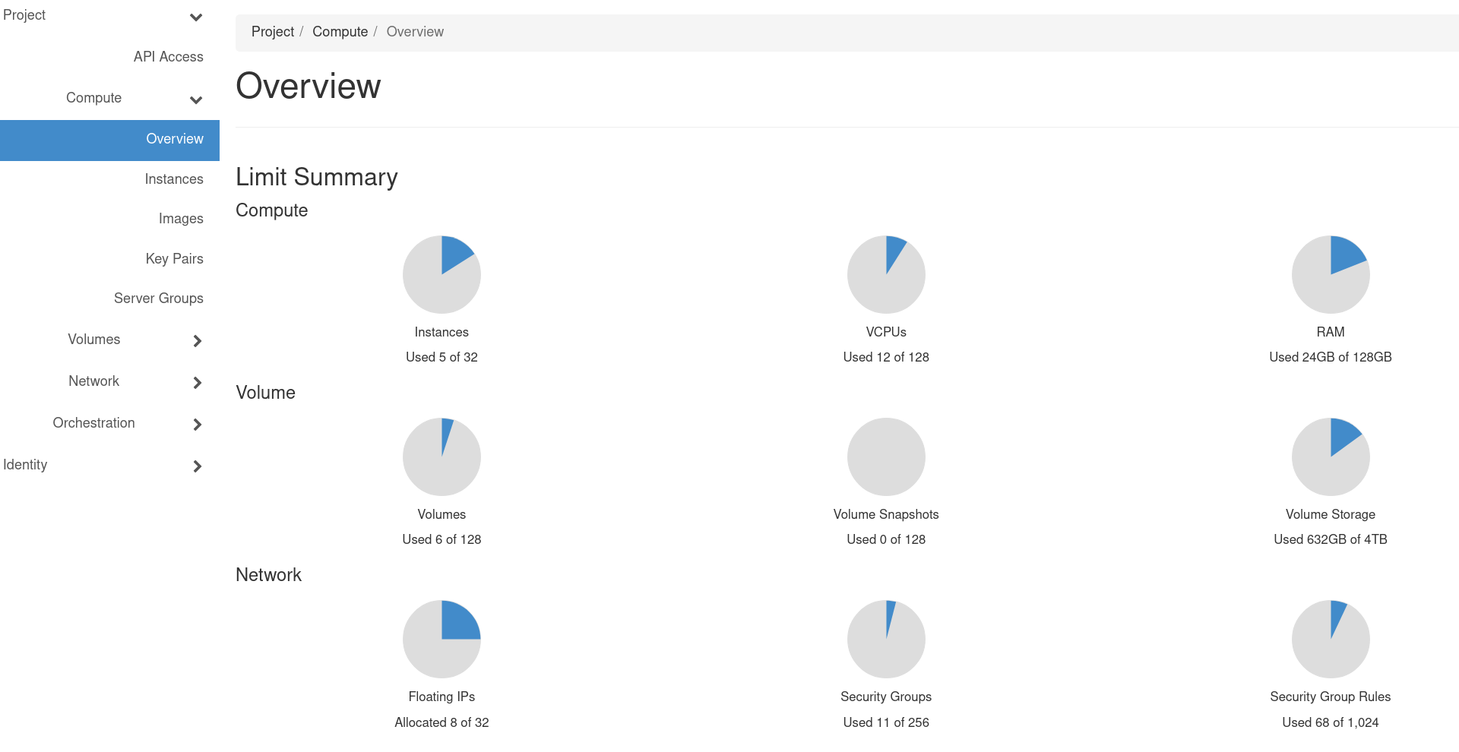
Navigate Horizon: Overview
Land on the Overview page under “Compute”
quick summary of your project

Slide 22
Navigate Horizon: Instances
Navigate to:
Project->Compute->Instances
Instances are virtual machines that run inside the cloud, more simply: an instance is just a digital version of a physical computer
Instances can perform almost all the same functions as a computer, including running applications and operating systems

Slide 23
Instance Creation

Slide 24
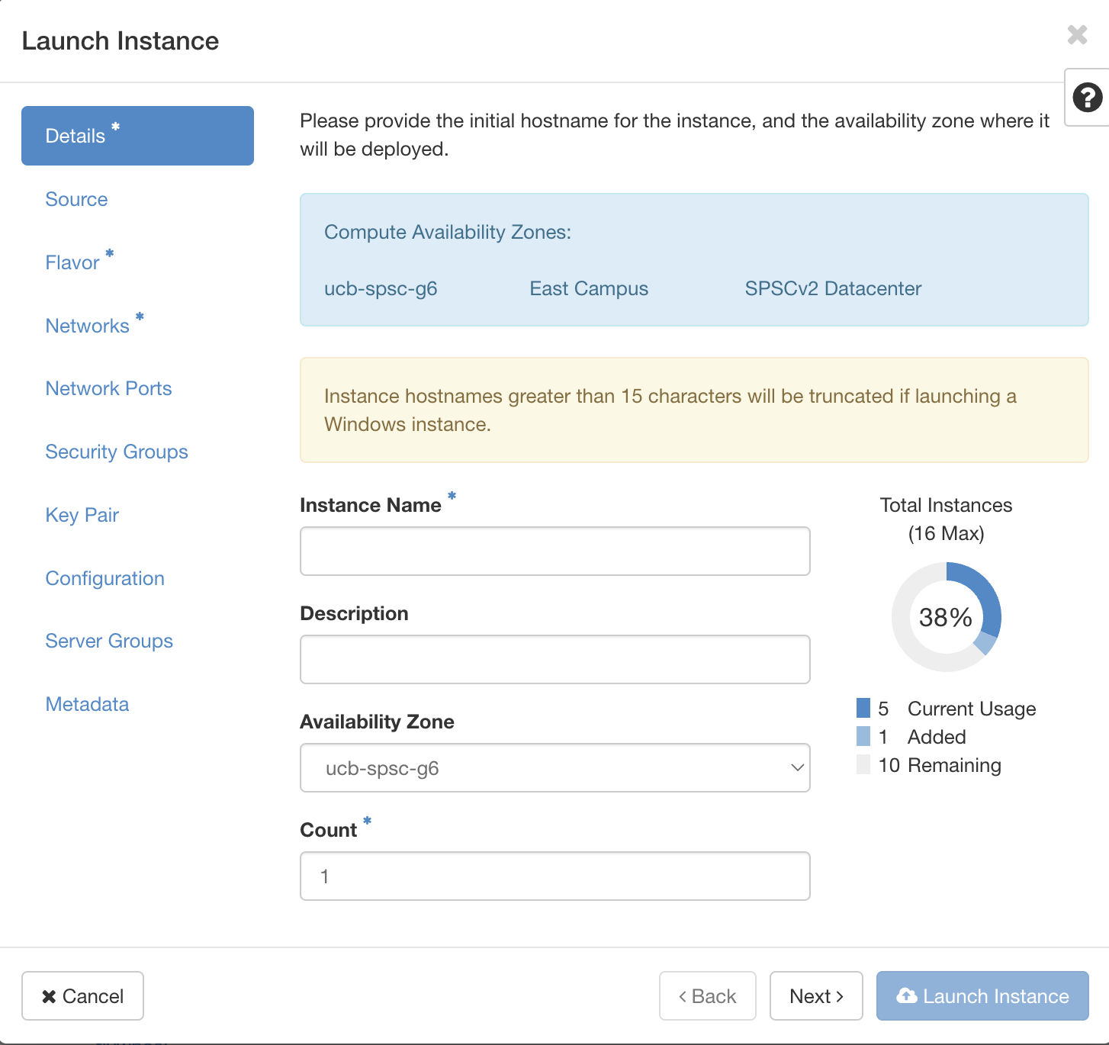
Let’s create a simple instance together
From the instances page click on “Launch Instance”
The Instance Creation Launcher will pop up giving us options to create our virtual machine

Slide 25
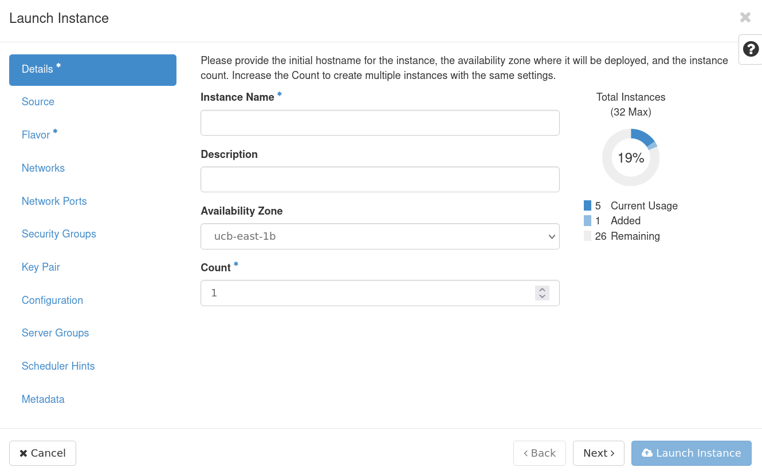
Details
Fill out Instance details, including a name and description
availability zone and count can be left as defaults

Slide 26
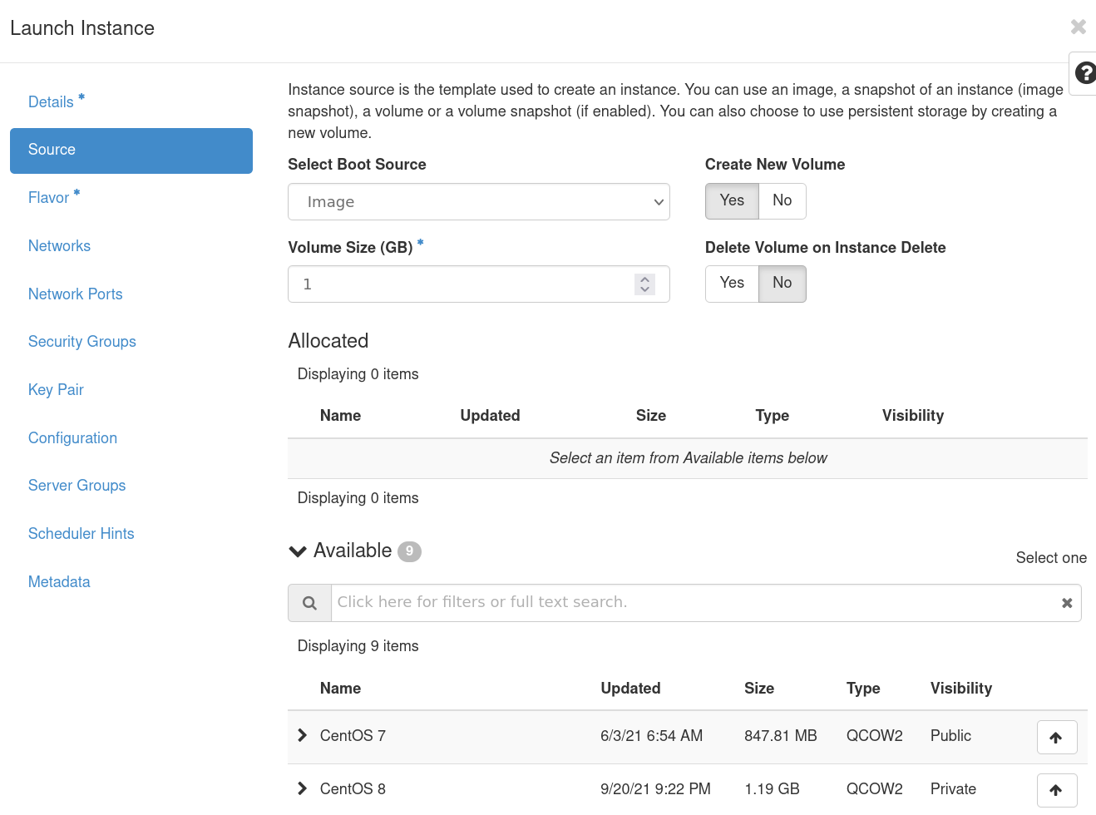
Source
Choose an image from the available list
A virtual machine image (“image”) is a single file that contains a virtual disk that contains a bootable operating system
Choose to have your storage volume deleted on instance deletion
If you select “no” be aware of “zombie” volumes

Slide 27
Source
A brief note about Source Images
We have custom images for things like The Littlest JupyterHub, Rstudio Server, Galaxy Server, and LAMP servers.
Makes setup simple for these tools, with only the need to setup SSL.
Anything else you would find useful?

Slide 28
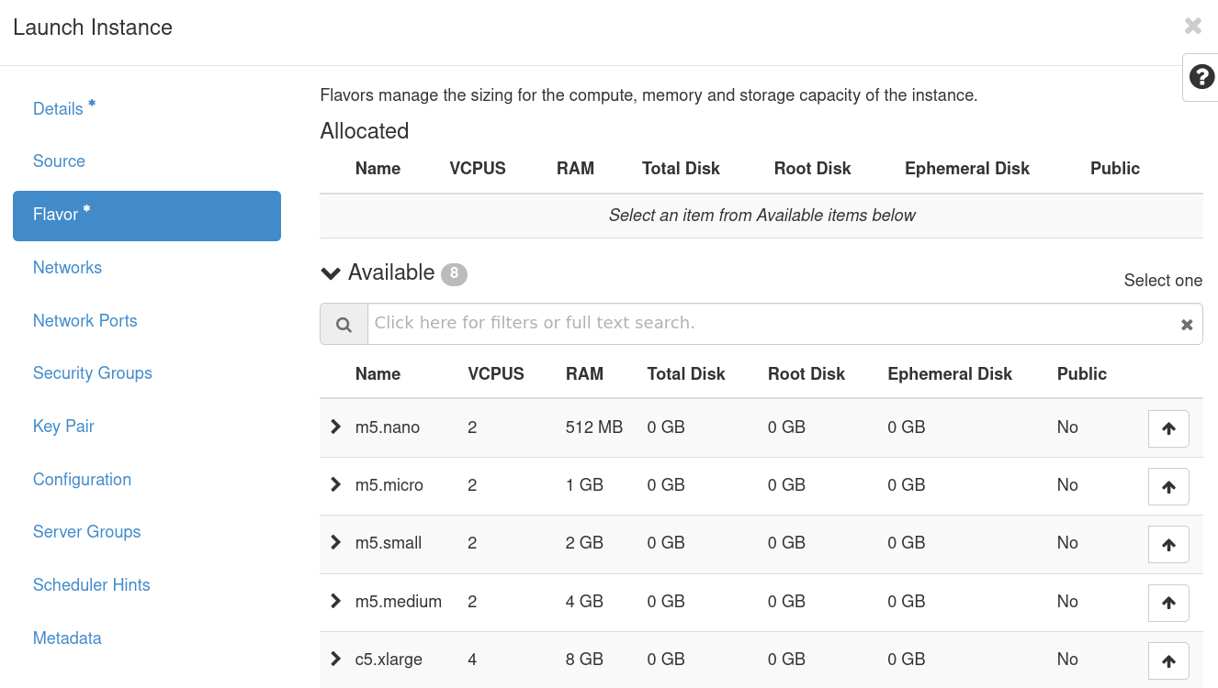
Flavor
Choose from a list of pre-selected resources:
A flavor defines the compute and memory capacity of our instance.
One CUmulus, we have a maximum allowed flavor of:
24 vCPUs
96GB RAM

Slide 29
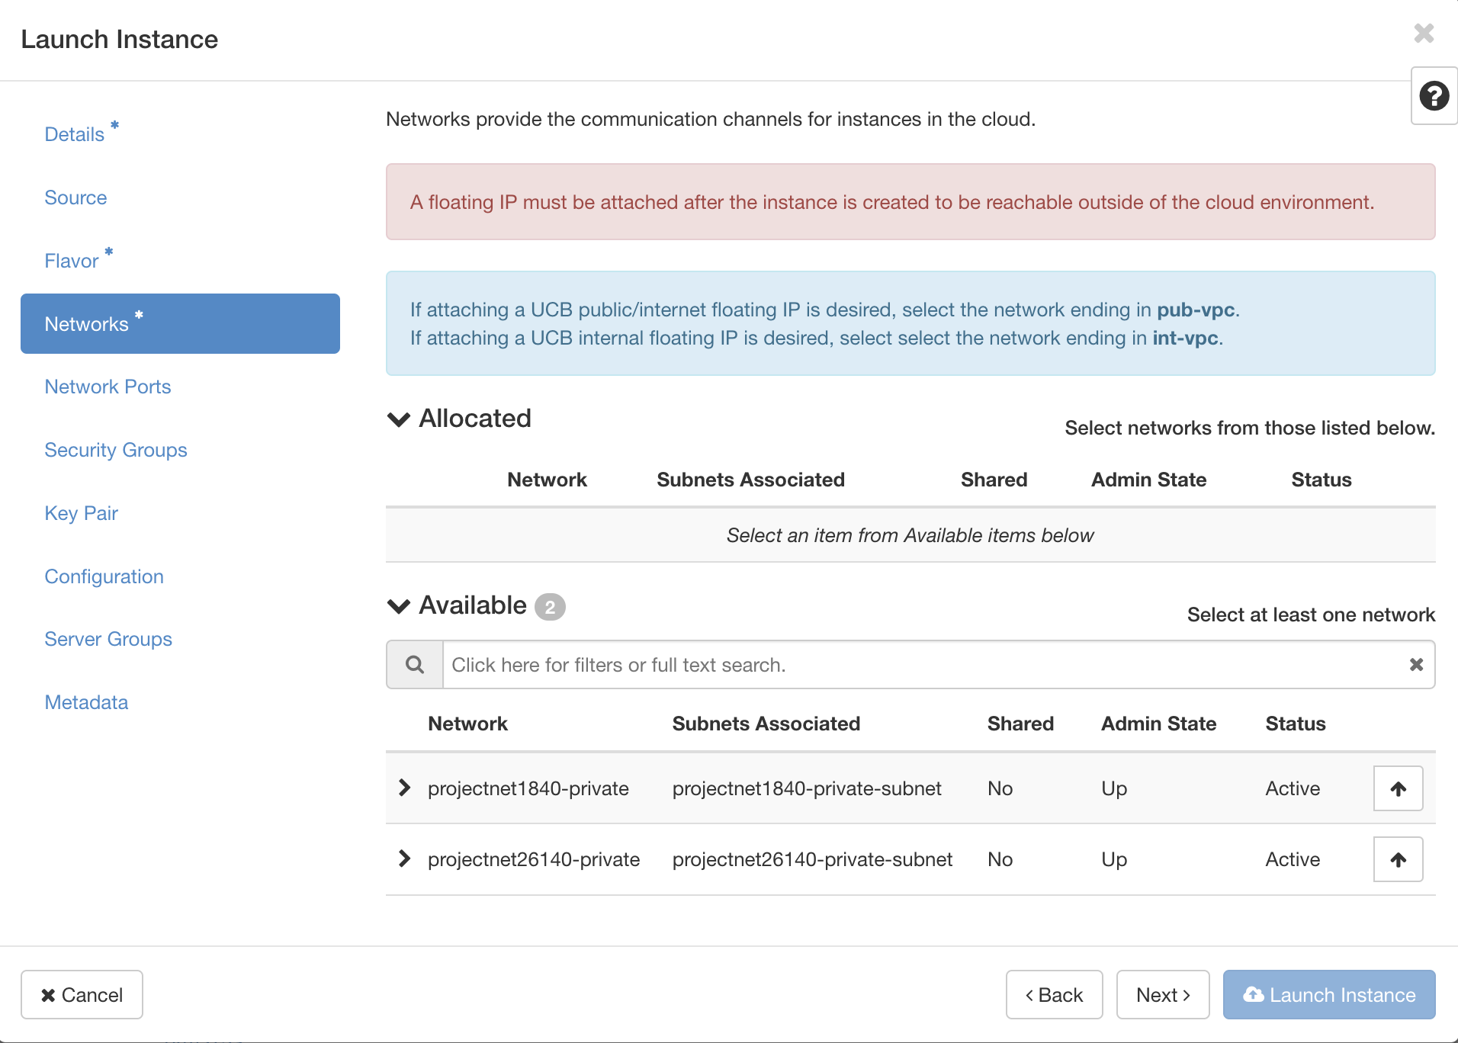
Networks & Network Ports
Select a project network, which determines routability of either a public/internet or campus/internal floating IP.
We’ll choose an external network:
Projectnet26140-private
Ports provide extra communication channels to your instances
You can select ports instead of networks or a mix of both

Slide 30
Networks: An aside
Two network types are provided:
Private Network- restricts your instance to CU internal network
Public Network- allows certain ingress/egress from the public internet (for certain access, e.g http, https)
Direct shell access (e.g. ssh, powershell) is restricted to the CU internal network due to multi-factor-authentication requirements
This means that you will need to be on the CU network to access your instance (either VPN or through RC).

Slide 31
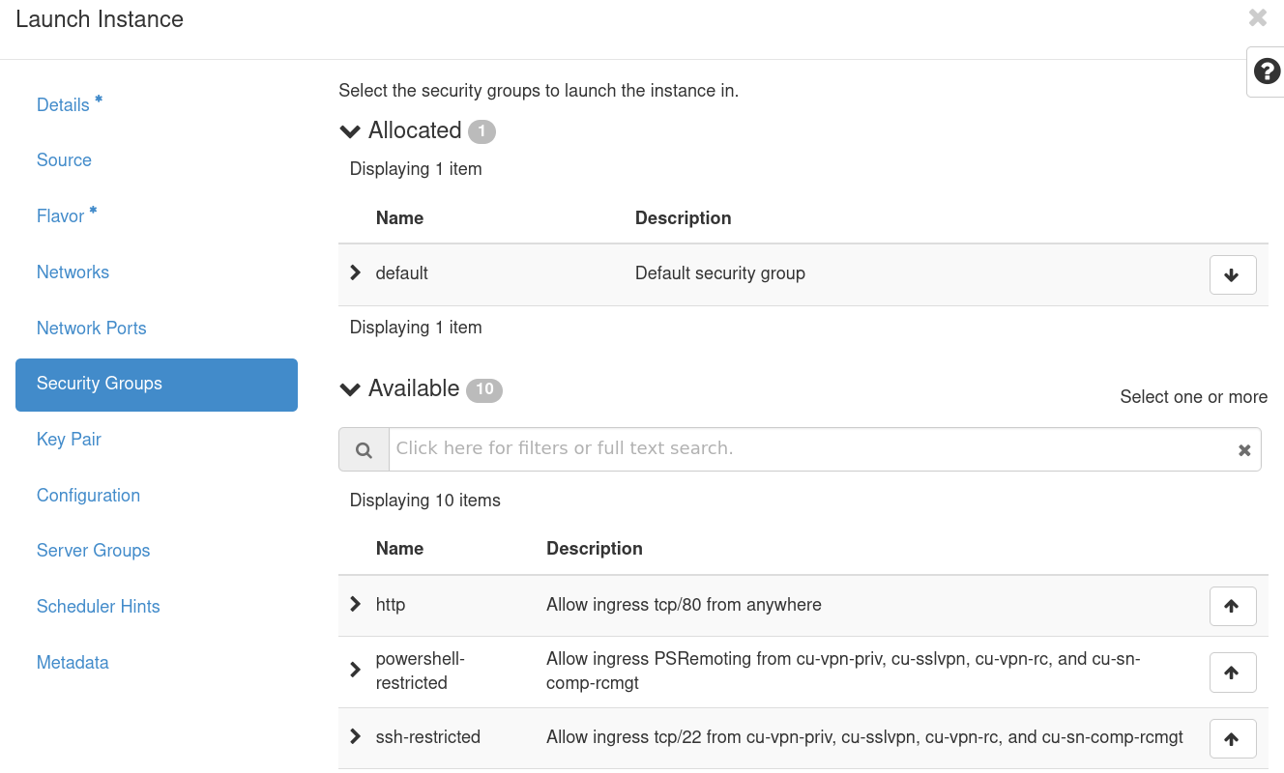
Security Groups
Security Groups act as a virtual firewall for your instance to control inbound and outbound traffic.
Note: We can create custom security groups if there are specific ports you need opened
We’ll choose ssh-curc, ssh-restricted, http, and https for our demo

Slide 32
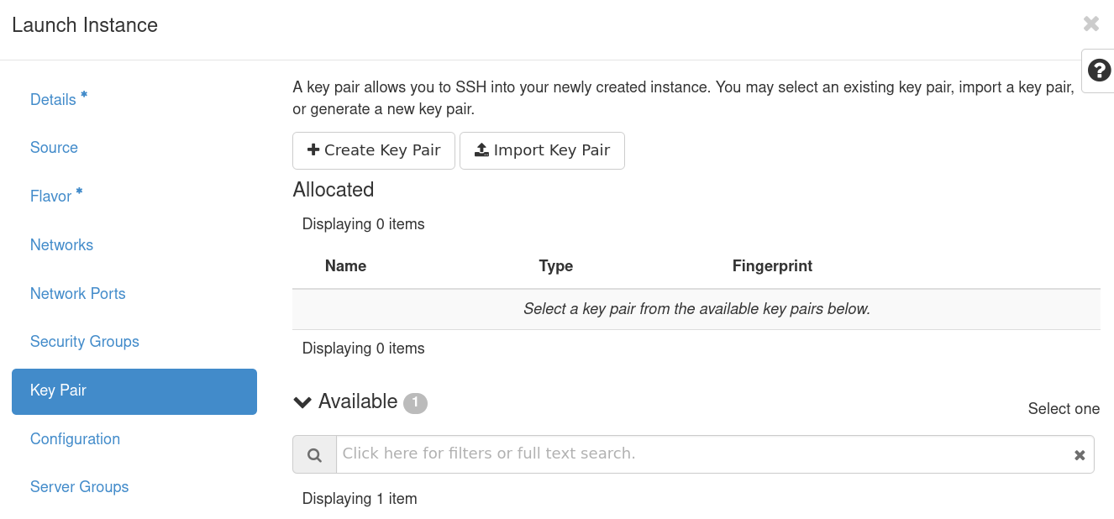
Key Pairs
A key pair allows you to SSH into your new instance
You may select an existing key pair, or import a key pairI find it easiest to create a keypair on my machine and import it
https://www.ssh.com/academy/ssh/public-key-authentication
Notes:
ssh-keygen -t ed25519
Generating public/private ed25519 key pair.
Enter file in which to save the key (/home/username/.ssh/id_ed25519):

Slide 33
Key Pairs: An aside
You will need to create an SSH key from or copy it to a computer you have CU internal access to:
If you have an RC account already, login as follows from a terminal:
$ ssh <username>@login.rc.colorado.edu
# Where <username> is your identikey

Slide 34
Key Pairs: An aside
SSH keys are an access credential that is used in the SSH protocol
They can be tricky to set up however, so we'll go over a simple example here. From your terminal in a local machine use the ssh-keygen command to create a new ssh keypair:
Our new keypairs have been created at /home/username/.ssh/ and are called id_ed25519 and id_ed25519.pub. The public key (.pub) can be transferred to other remote servers (this is the key we will import to our CUmulus instance) but the private key (no suffix) should never leave the host machine.
$ ssh-keygen -t ed25519
Generating public/private ed25519 key pair.
Enter file in which to save the key (/home/username/.ssh/id_ed25519):

Slide 35
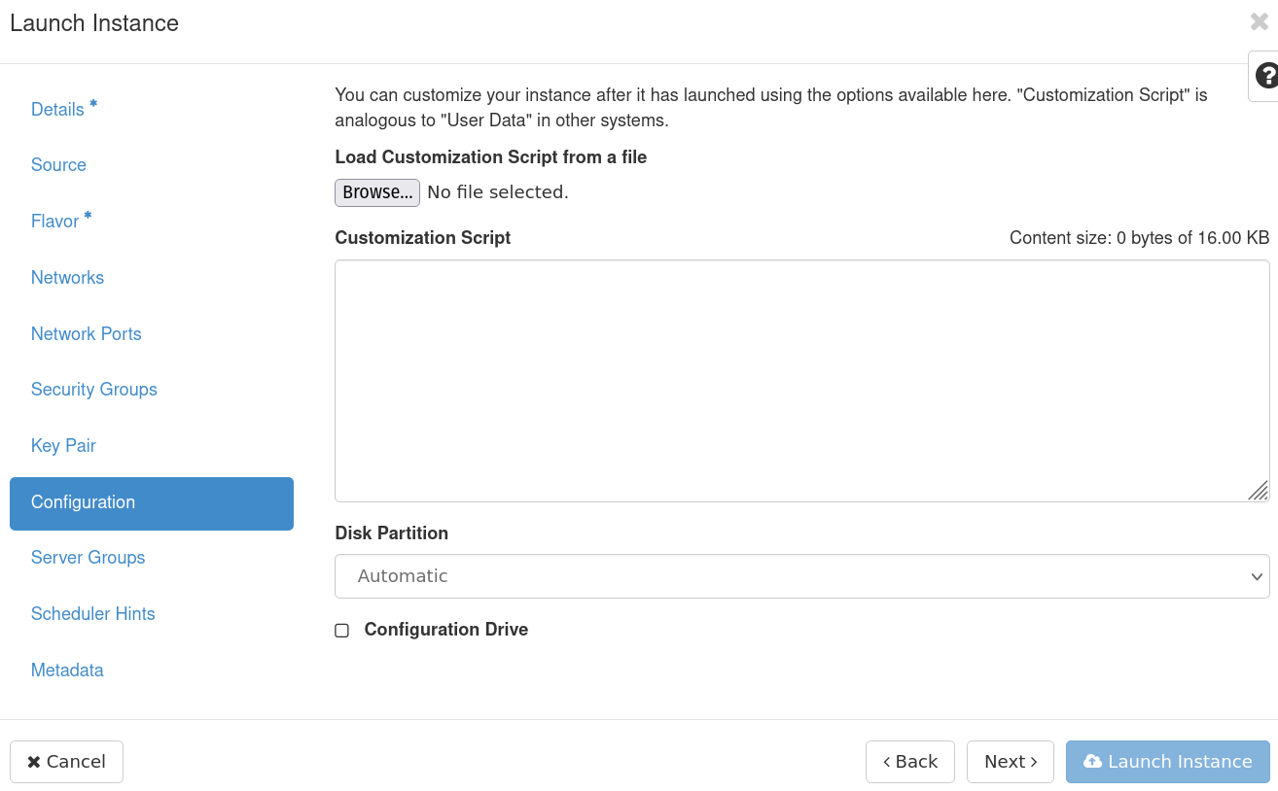
Config, Server Group, Scheduler Hints, and Metadata
We’ll leave these as defaults as they are extra configuration we can provide our instances, but not necessary

Slide 36
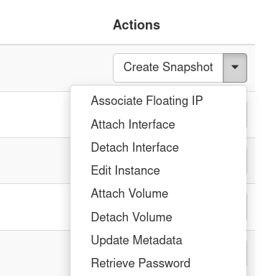
Launch Instance and Associate IP
Launch instance and wait for it to be set up
In the meantime, we can associate a Floating IP which will allow us to access the instance from outside of the CU network
On the right-hand side of the newly created instance choose “Associate Floating IP” under the “actions” dropdown

Slide 37
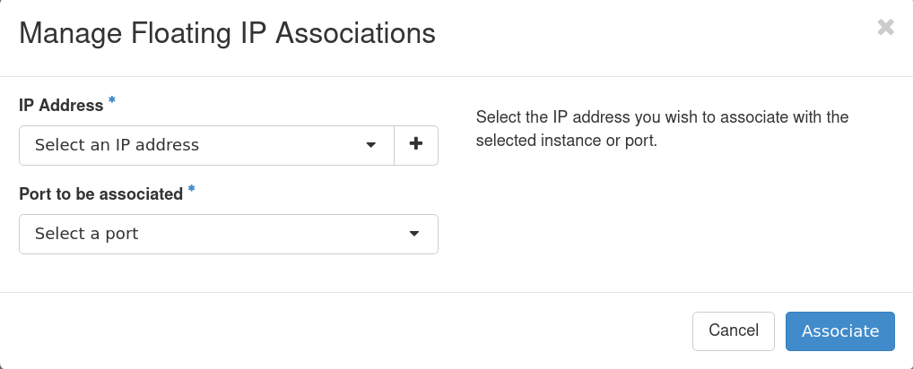
Associate IP
Select from available IP addresses
If needed, you can add a floating IP
Select port to be associated
This should be pre-populated with the internal IP of your new instance

Slide 38
Logging into your Instance

Slide 39
Logging In for RMACC
You must be on the CU internal to connect via ssh (CURC restriction)
Login to Open OnDemand and open an alpine shell
ondemand-rmacc.rc.colorado.edu
SSH to your instance:
$ ssh -i ~/.ssh/testkey ubuntu@123.456.789.123

Slide 40
Logging In for CU
You must be on the CU internal to connect via ssh (CURC restriction)
Open up an ssh connection providing the identity (key) file:
For an ubuntu instance this will look something like:
$ ssh -i ~/.ssh/<private key> <hostname>@<external floating IP>
$ ssh -i ~/.ssh/testkey ubuntu@123.456.789.123

Slide 41
Logged In
Congratulations! You are now logged into your instance
You can now:
Install Software
Administer your instance
Run applications and jobs

Slide 42
Demo

Slide 43
Demos:
Setting up an Instance
CUmulus integration with CURC HPC
Mounting a remote filesystem from a CUmulus Virtual Machine
Users that are not using tutorial accounts may access CUmulus and your instances for the next week to test and run through tutorials

Slide 44
Notes for Demo
To get the Slurm Conf File
scp -i ~/.ssh/id_ed25519 /curc/slurm/alpine/etc/slurm.conf ubuntu@<your floating ip>:/home/ubuntu
Downloading SLURM
sudo git clone -b slurm-23-02-1-1 https://github.com/SchedMD/slurm.git
Run Sample Job
sbatch --qos=normal --chdir="/home/<yourusername>" --wrap="hostname"

Slide 45
Any Questions?

Slide 46
Today’s Agenda

Slide 47
Thank you!
Contact: anwi7603@colorado.edu
Help Desk: rc-help@colorado.edu

